Slide 1
International funding programs; Switzerland and Austria
Ebrahim Nadimi
Vice-Provost for International Development
K. N. Toosi University of technology

Slide 2
Contents
Introduction; Why Switzerland and Austria?
Universities in Switzerland
Universities in Austria

Slide 3
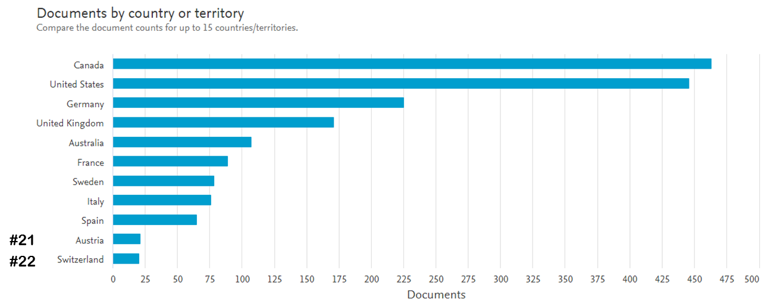
Introduction
KNTU’s Joint Publications
#1 Canada
#2 USA
#3 Germany
DAAD, DFG, BMBF/MSRT
#4 UK
#5 Australia
#6 France
Jondishapour
#7 Sweden
#8 Italy
#9 Spain
#21 Autsria
OeAd, OeFG, Impulse
#22 Switzerland
SNSF, Seed Money Grants, Bridging Grants

Slide 4
Introduction
Joint Publications of other Iranian Universities with Switzerland

Slide 5
Introduction
Joint Projects with Switzerland |  | Joint Projects with Austria
Uromia Uni. | Shiraz Uni. (2) | IPM | Azad Uni. Najafabad
Isfahan Uni. Med. | Amir Kabir Uni. Tech. | Art Uni. Isfahan | Uni. Gilan
Shahid Rajaee Uni. | Shahid Beheshti Uni. | Isfahan Uni. Tech. | Uni. Isfahan
Isfahan Uni. Tech. (4) | IPM | Kharazmi Uni. (2) | Uni. Shahrood
Uni. Isfahan | Shiraz Uni. Med. | Uni. Semnan | Uni. Tehran
Uni. Tehran | Mashhad Uni. Med. | Shahid Bahonar Uni. | Tarbiat Modares Uni. (2)
Tarbiat Modares Uni. (2) | Shahid Sadougi Uni. Med. | Iran Uni Sci. Tech. | Uni. Tabriz (2)
Tehran Uni. Med. (2)

Slide 6
Introduction
Isfahan University of Technology as the leading house for Iran-Switzerland scientific collaborations
Kharazmi University as the leading house for Iran-Austria scientific collaborations

Slide 7
Contents
Introduction; Why Switzerland and Austria?
Universities in Switzerland
Universities in Austria

Slide 8
Universities in Switzerland
Higher levels of education, three main categories based on national regulations for funding:
Universities run by confederation, universities run by cantons and universities of applied sciences (UAS)
Universities run by confederation (2), cover a broad spectrum of academic subjects:
Swiss Federal Institute of Technology Lausanne (EPFL) (Lausanne), French/English-speaking
Swiss Federal Institute of Technology Zurich (ETH) (Zurich), German/English-speaking
Universities run by cantons (10), in general provide non-technical subjects:
University of Basel (Basel)
University of Bern (Bern)
University of Fribourg (Fribourg)
University of Geneva (Geneva)
University of Neuchâtel (Neuchâtel)
University of Lausanne (Lausanne)
University of Lucerne (Lucerne)
University of Lugano (Lugano)
University of St. Gallen (HSG) (St. Gallen)
University of Zurich (Zürich)
Universities of Applied Sciences (8), for specific occupations in line with trade, art and industry:
Zürcher Fachhochschule-ZFH, including ZHAW
Berner Fachhochschule, BFH
Fachhochschule Nordwestschweiz, FHNW
Fachhochschule Ostschweiz, FHO
HES-SO Haute école spécialisée de Suisse occidentale
Hochschule Luzern, HSLU
Scuola universitaria professionale della Svizzera italiana, SUPSI
Kalaidos University of Applied Sciences, Kalaidos UAS

Slide 9
Universities in Switzerland
Top ranked universities in Switzerland
University | QS ranking
ETH Zurich | 6
EPFL Lausanne | 20
University of Zurich | 76
University of Geneva | 110
University of Bern | 123
University of Basel | 151
Universities run by confederation
universities run by cantons

Slide 10
Universities in Switzerland
ETH Zurich (https://ethz.ch/en):
Founded in 1855
around 21,000 students
5 departments
Departments:
Architecture and Civil Engineering: Architecture, Civil, Environmental and Geomatic Engineering
Engineering Sciences: Biosystems Science and Engineering, Computer Science, Information Technology and Electrical Engineering, Mechanical and Process Engineering, Materials
Natural Sciences and Mathematics: Biology, Chemistry and Applied Biosciences, Mathematics, Physics
System-oriented Natural Sciences: Earth Sciences, Environmental Systems Science, Health Sciences and Technology
Management and Social Sciences: Management, Technology and Economics, Humanities, Social and Political Sciences

Slide 11
Universities in Switzerland
EPFL- École Polytechnique Fédérale de Lausanne (https://www.epfl.ch/en/)
Founded in 1853
around 11,000 students
6 departments
Departments:
Architecture, Civil and Environmental Engineering ENAC: Architecture, Civil Engineering Environmental Engineering, Urban Planning
Basic Sciences SB: Chemistry, Mathematics, Physics
Engineering STI: Electrical Engineering, Mechanical Engineering, Materials Science and Engineering, Microengineering, Bioengineering
Computer and Communication Sciences IC: Computer Science, Communication Systems
Management of Technology CDM: Management of Technology, Technology and Public Policy, Financial Engineering
College of Humanities CDH

Slide 12
Universities in Switzerland
University of Basel (https://www.unibas.ch/en.html)
Founded in 1460
Around 13,000 students
7 faculties, 13 different engineering science programs
Relevant Faculties and Institutes:
Faculty of Science: Department Biozentrum, Department of Chemistry, Department of Physics, Department of Mathematics and Computer Science, Department of Pharmaceutical Sciences, Swiss Nanoscience Institute, Department of Environmental Science
Associated Institutes: Friedrich Miescher Institute for Biomedical Research (FMI)

Slide 13
Universities in Switzerland
University of Zurich (https://www.uzh.ch/en.html)
Founded in 1833
Around 26,000 students
7 faculties
Relevant faculties:
Faculty of Science: Department of Chemistry, Department of Physics, Department of Mathematics, Institute for Computational Science, Institute of Molecular Life Sciences

Slide 14
Universities in Switzerland
Zurich University of Applied Sciences / ZHAW (https://www.uzh.ch/en.html)
Founded in 2007, by merging four independent institutions
Around 11,000 students
8 schools
Relevant schools:
School of Architecture, Design, and Civil Engineering
School of Engineering:
Institute of Applied Information Technology (InIT)
Institute of Applied Mathematics and Physics (IAMP)
Institute of Data Analysis and Process Design (IDP)
Institute of Energy Systems and Fluid Engineering (IEFE)
Institute of Mechanical Systems (IMES)
Institute of Mechatronic Systems (IMS)
Institute of Sustainable Development (INE)
Institute of Signal Processing and Wireless Communications (ISC)
Institute of Computational Physics (ICP)
Institute of Embedded Systems (InES)
Institute of Materials and Process Engineering (IMPE)
Centre for Aviation (ZAV)
Centre for Product and Process Development (ZPP)

Slide 15
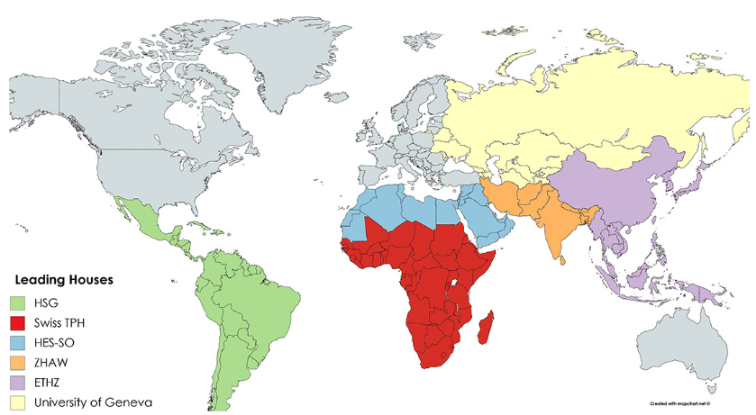
Universities in Switzerland

Slide 16
Contents
Introduction; Why Switzerland and Austria?
Universities in Switzerland
Universities in Austria

Slide 17
Universities in Austria
Higher levels of education, three main categories based on national regulations for funding:
Federal Universities (Universitäten), Private Universities (Privatuniversitäten) and Universities of Applied Science (Fachhochschulen).
Federal Universities (22), cover a broad spectrum of academic subjects:
University of Vienna
TU Wien (Vienna University of Technology)
University of Innsbruck
and …
Private Universities (16), provide innovative, high quality education in the fields of music, art, business, economics and ...:
Music and Arts University of the City of Vienna
Popular Music Vienna
and …
Universities of Applied Sciences (21), for specific occupations in line with trade and industry:
FHWien der WKW – University of Applied Sciences for Management & Communication
UAS Technikum Wien (Vienna)
University of Applied Sciences BFI Vienna
and …

Slide 18
Universities in Austria
Top ranked universities in Austria
University | QS ranking
University of Vienna | 154
TU Wien | 192
University of Innsbruck | 266
Graz University of Technology | 311
Johannes kepler university linz | 412
University of Graz | 541
Alpen-Adria-Universität Klagenfurt | 601
University of Salzburg | 751
Federal Universities (22), cover a broad spectrum of academic subjects:
University of Vienna
TU Wien (Vienna University of Technology)
University of Innsbruck
and …

Slide 19
Universities in Austria
Top ranked universities in Austria
University | QS ranking
University of Vienna | 154
TU Wien | 192
University of Innsbruck | 266
Graz University of Technology | 311
Johannes kepler university linz | 412
University of Graz | 541
Alpen-Adria-Aniversität Klagenfurt | 601
University of Salzburg | 751
University of Vienna (https://www.univie.ac.at/en/):
Founded in 1365
92,000 students
40 education and training programmes
15 faculties and five centres
Relevant Faculties:
Faculty of Physics
Faculty of Chemistry
Faculty of Earth Sciences, Geography and Astronomy
Faculty of Mathematics
Faculty of Computer Science

Slide 20
Universities in Austria
Top ranked universities in Austria
University | QS ranking
University of Vienna | 154
TU Wien | 192
University of Innsbruck | 266
Graz University of Technology | 311
Johannes kepler university linz | 412
University of Graz | 541
Alpen-Adria-Aniversität Klagenfurt | 601
University of Salzburg | 751
TU Wien (https://www.tuwien.at/en/):
Founded in 1815, currently ~30,000 students
8 faculties and 51 institutes
Faculties:
Faculty of Architecture and Planning
Faculty of Civil Engineering
Faculty of Electrical Engineering and Information Technology
Faculty of Informatics
Faculty of Mechanical and Industrial Engineering
Faculty of Mathematics and Geoinformation
Faculty of Physics
Faculty of Technical Chemistry

Slide 21
Universities in Austria
Top ranked universities in Austria
University | QS ranking
University of Vienna | 154
TU Wien | 192
University of Innsbruck | 266
Graz University of Technology | 311
Johannes kepler university linz | 412
University of Graz | 541
Alpen-Adria-Aniversität Klagenfurt | 601
University of Salzburg | 751
University of Innsbruck (https://www.uibk.ac.at/universitaet/):
Founded in 1669, currently ~30,000 students
16 faculties and 81 departments
Relevant Faculties:
Faculty of Architecture
Faculty of Chemistry and Pharmacy
Faculty of Engineering Sciences (Mechanics, Geotechnical and Tunneling, Environmental Engineering, Hydraulic Engineering, Structural Engineering, Material Sciences)
Faculty of Geo- and Atmospheric Sciences
Faculty of Mathematics, Computer Science and Physics

Slide 22
Universities in Austria
Top ranked universities in Austria
University | QS ranking
University of Vienna | 154
TU Wien | 192
University of Innsbruck | 266
Graz University of Technology | 311
Johannes kepler university linz | 412
University of Graz | 541
Alpen-Adria-Aniversität Klagenfurt | 601
University of Salzburg | 751
Graz University of Technology (www.tugraz.at/home/):
Founded in 1811, currently ~17,500 students
7 faculties and 94 institutes
Faculties:
Faculty of Architecture
Faculty of Civil Engineering
Faculty of Computer Science
Faculty of Electrical and Information Engineering
Faculty of Mathematics, Physics and Geodesy
Faculty of Mechanical Engineering
Faculty of Technical Chemistry, Chemical and Process Engineering and Biotechnology

Slide 23
Universities in Austria
Top ranked universities in Austria
University | QS ranking
University of Vienna | 154
TU Wien | 192
University of Innsbruck | 266
Graz University of Technology | 311
Johannes kepler university linz | 412
University of Graz | 541
Alpen-Adria-Aniversität Klagenfurt | 601
University of Salzburg | 751
Johannes Kepler University Linz (https://www.jku.at/):
Founded in 1966, currently ~18,000 students
Four faculties and three schools
Relevant Faculties:
The Faculty of Engineering & Natural Sciences (Chemistry and Polymer Engineering, Computer Science, Mathematics, Mechatronics, Physics)
Linz Institute of Technology (Chemistry, Polymer Engineering Technologies, Physics, Computer Science, Mathematics, Mechatronics, Electronics and Information Technology)

Slide 24
Funding
International academic funding opportunities are offered by different organizations/institutions in both countries:
Programs which support researchers, individually, to pursue their own research subjects: exchange opportunities, organize scientific events, research stay and …
Programs which support research teams (faculties/institutions) to develop international research projects
Programs which support faculties/institutions to developed jointly organized educational courses
Programs based on inter-governmental and bilateral agreements aimed to support international scientific activities

Slide 25
Funding
Iran-Switzerland
Bridging Grants
Call will be announced soon (expected submission deadline Jan. 2020)
Organized by IUT and ZHAW
KNTU will offer financial support to one project

Slide 26
Thank you
for your attention!

